Slide 1
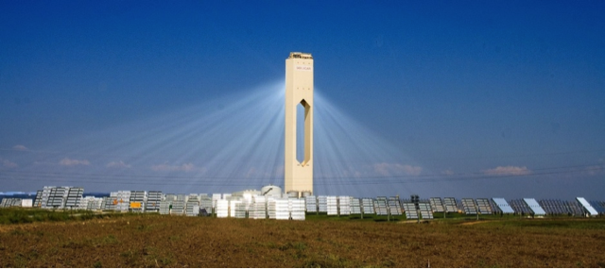
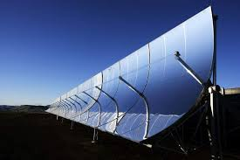
Renewable Energy Sources
UNIT: II
Solar electric systems energy storage

Slide 2
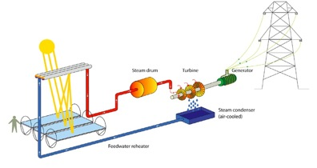
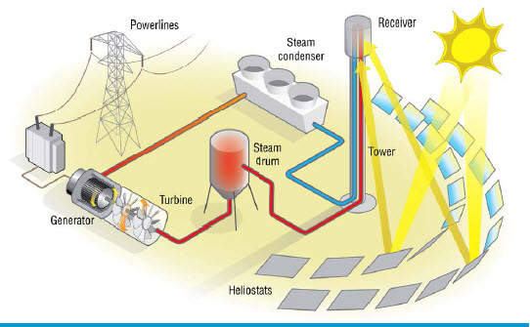
Solar thermal electric power generation
Solar thermal energy (Heat) is used to generate electricity.

Slide 3
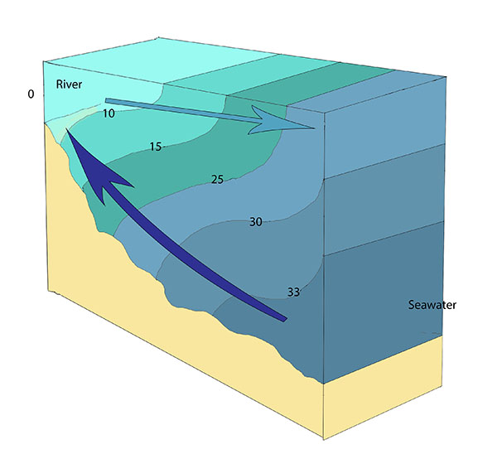
Solar pond:
A solar pond is a pool of saltwater which collects and stores solar thermal energy.
Salt brine has a good ability to trap the heat for a longer time.
The saltwater naturally forms a vertical salinity gradient also known as a "halocline", in which low-salinity water floats on top of high-salinity water.
The layers of salt solutions increase in concentration (and therefore density) with depth.
This heat trapped is utilized to generate electricity.

Slide 4
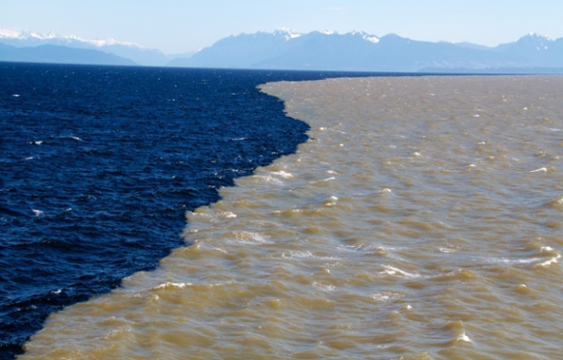
Salt water does not gets mixed easily with the fresh water (halocline)

Slide 5
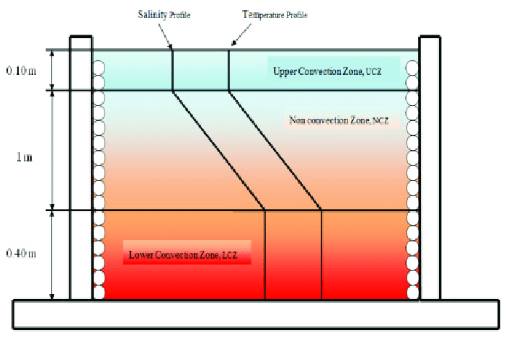
Solar Ponds:
Solar pond combines the functions of heat collection with long term storage and can provide sufficient heat for the entire year.
It is 1 – 2 mts deep with a thick durable plastic liner laid at the bottom.
Salts like magnesium chloride, sodium chloride or sodium nitrate are dissolved in water, the concentration varying from 20 – 30 % at the bottom to almost zero at the top.
In order to maintain the proper concentration level water is added at the top of the pond. At the same time concentrated brine is added at the bottom of the pond.
The amount of salt required for this purpose is about 50g/m²-day.
In order to extract the energy stored, hot water is removed continuously from the bottom, passed through a heat exchanger and returned to the bottom.

Slide 6
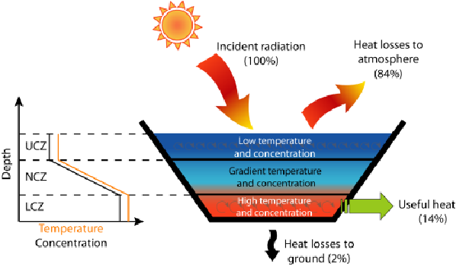
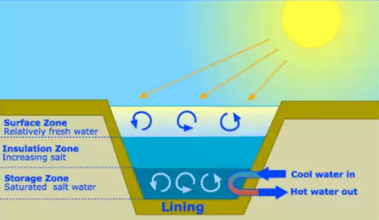
Layer-I (Upper Convection Zone):
It has small thickness around 0.10- 0.20 mtrs.
It has low, uniform concentration, which is close to zero as well as fairly uniform temperature.
Layer-II (Non- Convection zone):
It is much thicker and occupies more than half the ponds depth (1 to 1.5 mtrs). It serves principally as an insulating layer and reduces heat losses in the upward direction.
Some of heat collection takes place in this zones & it serves also as a part of the thermal storage.
Layer- III (Lower convection zone):
Its depth is similar to the non convection zone. Both the concentration and temperature are nearly constant in this zone. It serves the main heat collection as well as thermal storage medium. The lower convection zone is often referred to as the storage zone as the bottom layer.
The temperature at lower convection zone varies between 85°C to 95°C in summer and minimum of 50°C to 60°C in winter.
Annually collection efficiency ranges between 15 to 25%.

Slide 7
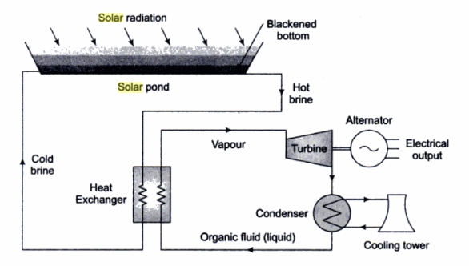
Solar Pond electricity generation:

Slide 8
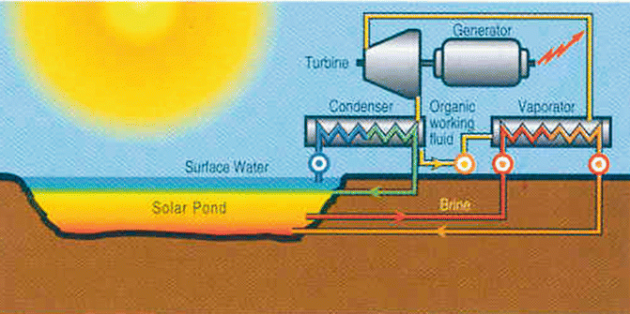

Slide 9
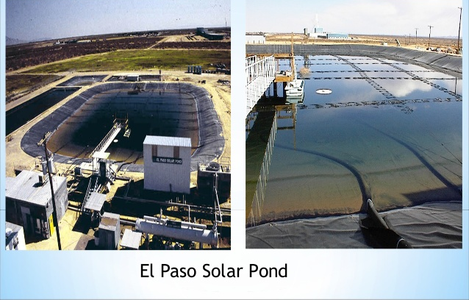
University of Texas, USA 150kW Solar pond Project:

Slide 10
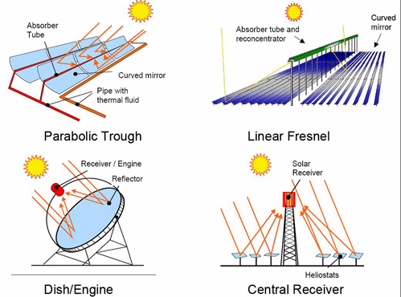
Solar thermal electric power generation using concentrating solar collector
Concentrating solar power (CSP) plants use mirrors or reflectors to concentrate the sun's energy to drive traditional steam turbines or engines that create electricity. The thermal energy concentrated in a CSP plant can be stored and used to produce electricity when it is needed, day or night.

Slide 11
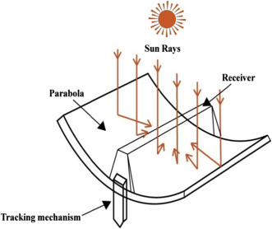
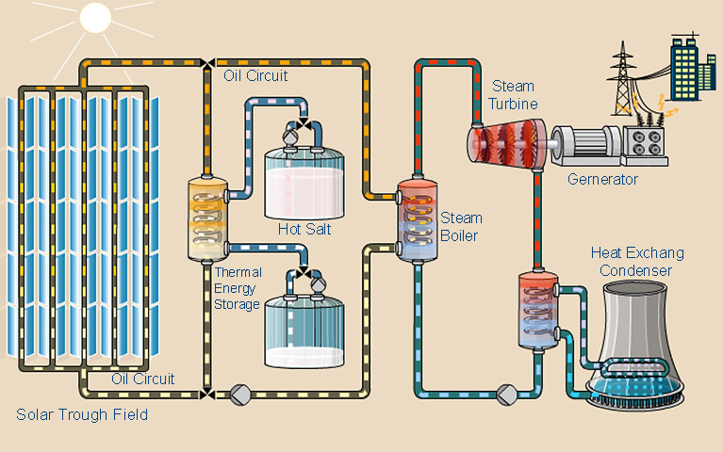
Parabolic trough solar concentrating

Slide 12
Working:
In parabolic trough collector, long, U-curved mirrors focus the rays of the sun into an absorber pipe.
The mirrors track the sun on one linear axis from north to south during the day.
The pipe is seated above the mirror in the center along the focal line and has a heat-absorbent medium (mineral oil, synthetic oil, molten salt etc.) running in it.
The sun’s energy heats up the oil, which carries the energy to the water in a boiler heat exchanger, reaching a temperature of about 400°C.
The heat is transferred into the water, producing steam to drive turbine and further electricity is generated via the alternators connected to this turbine.

Slide 13
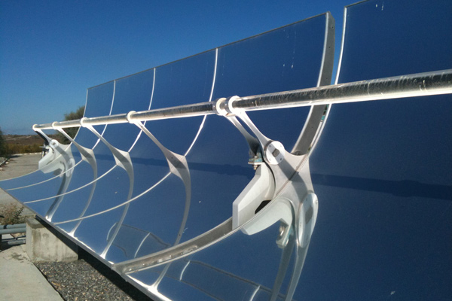
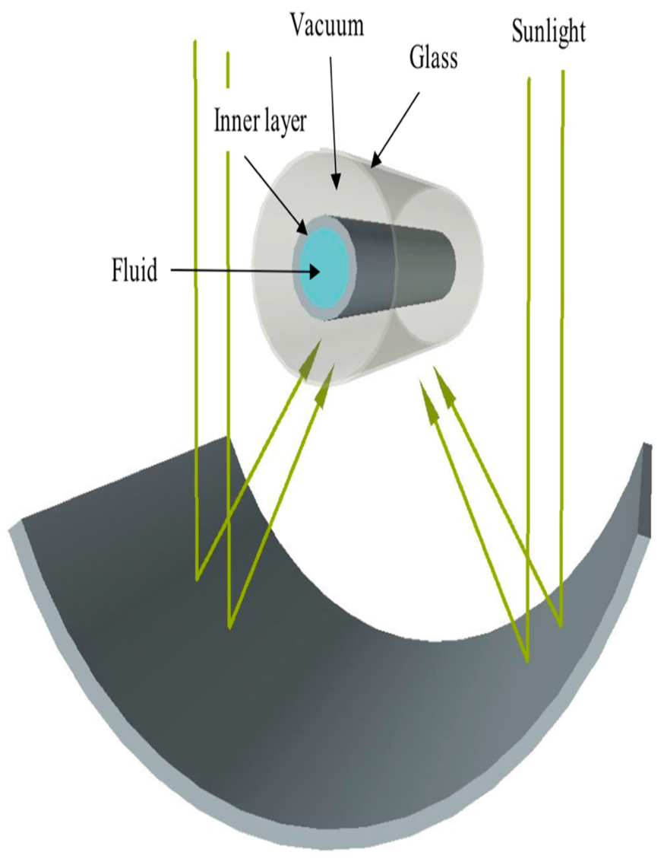

Slide 14
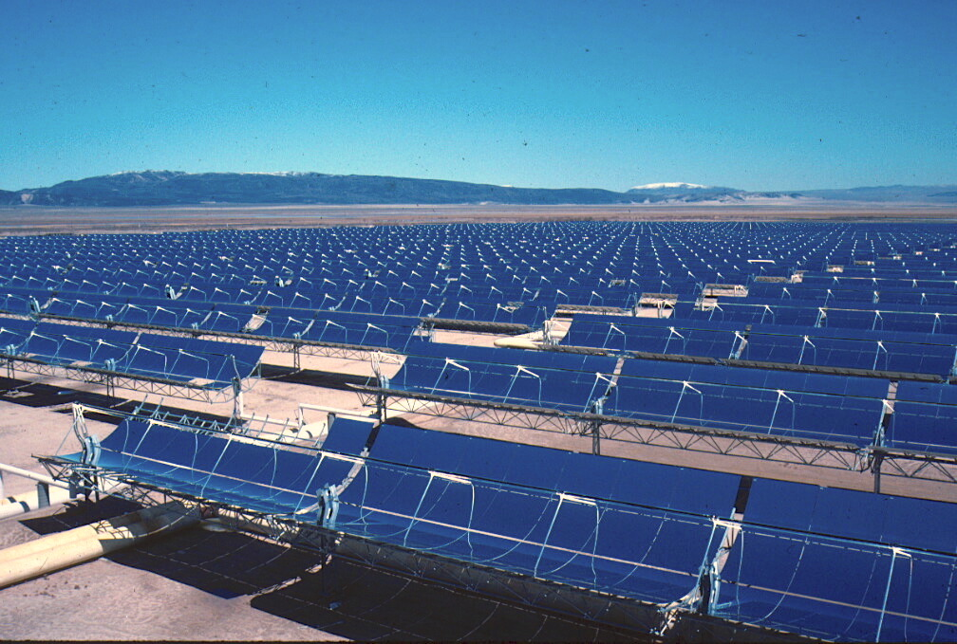
Examples: 310 MW, Mojave Desert, California (Worlds largest Parabolic trough solar concentrating power plant)

Slide 15
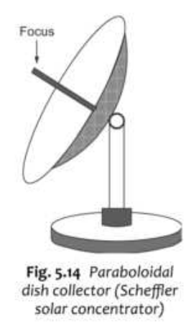
Parabolic dish solar concentrating
This concentrator has a dish with paraboloidal shape.
Paraboloidal is a surface generated by the rotation of a parabola about its axis.
Here, the beem radiation is focused at a perticular point in the paraboloidal.
This system requires a duel axis tracking so as to extract the maximum energy thought the day and the year.
It has a concentration ratio ranging from 10 to few thousands.
It can yield a temperature of about 3000 degree Celsius.
The dish collectors of diameter 6 to 7 mtrs are commercially manufactured.

Slide 16
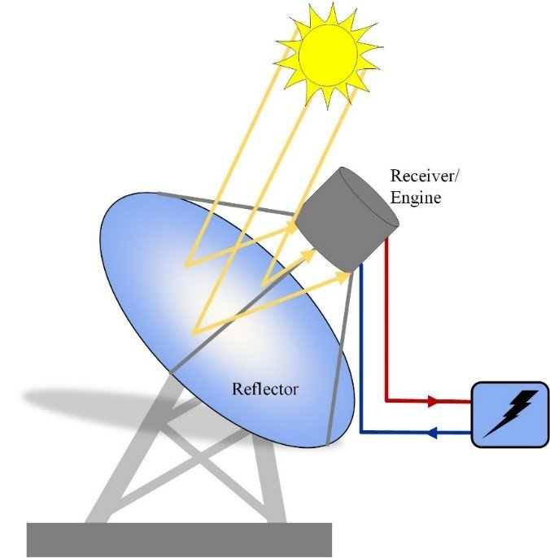
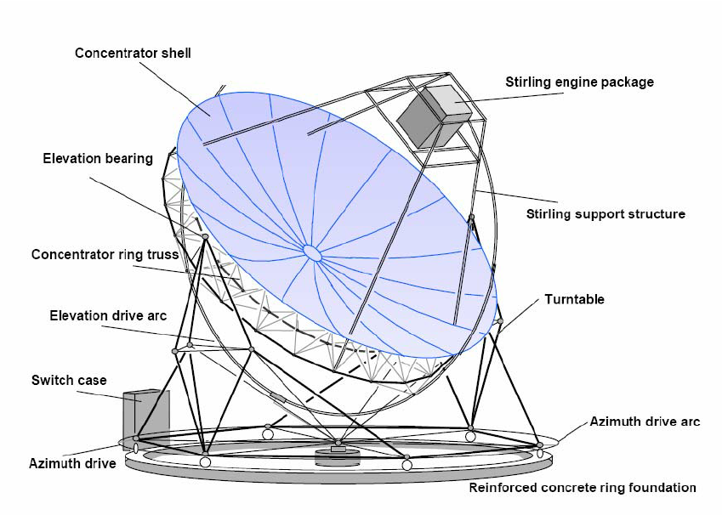

Slide 17
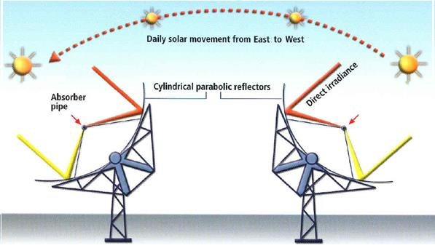
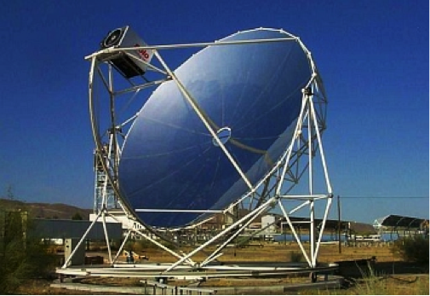

Slide 18
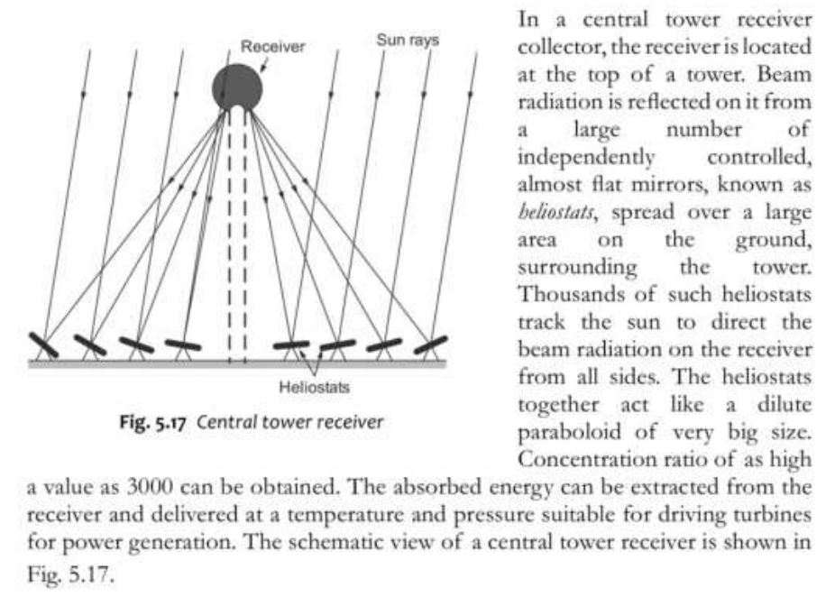
Central Tower Collector:

Slide 19
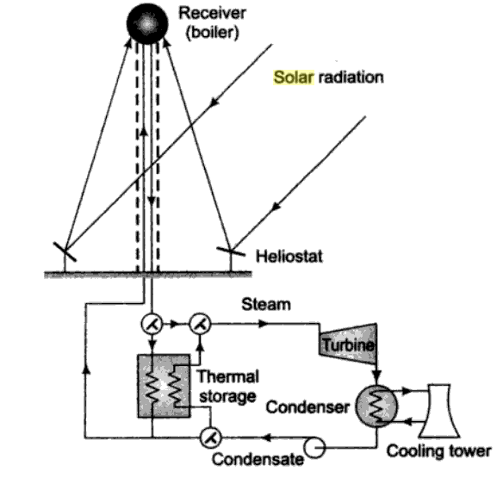
Working:

Slide 20
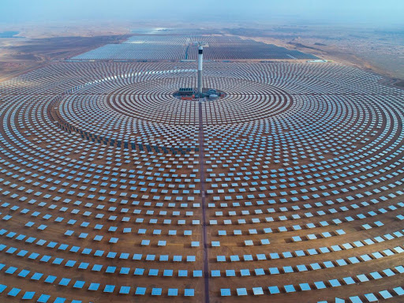
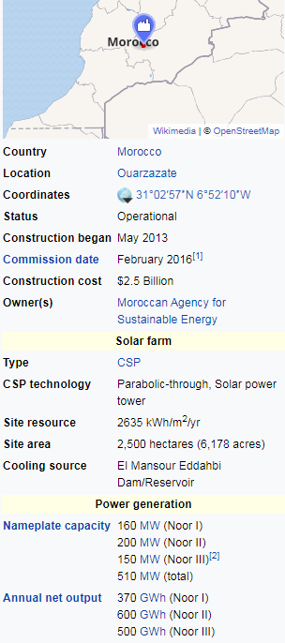
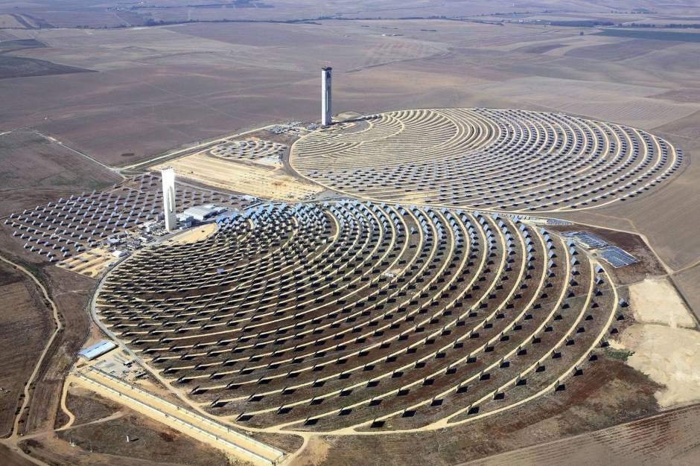
510 MW, Noor Power Station (Central Tower Collector)

Slide 21
Advantages and Disadvantages:
Advantages
Renewable energy
Carbon-free
Can serve as a drop-in replacement for conventional fuels to make steam
Operating costs are low
Can utilize thermal storage to better match supply with demand
High efficiency
Scalable to the 100MW+ level
Disadvantages:
Intermittent
Low energy density
Construction/installation costs are high
They require a considerable amount of space
Manufacturing processes often create pollution
Heavily location dependent
Will involve significant transmission distances/losses

Slide 22
Thank You

